Slide 1
Java Swing
Understand the basics of Java Swing.
Learn how to create a simple Swing application.
Explore key Swing components and their usage.
Apply OOP principles in building a Swing application.
Presented by: Prof. Cyrus Rj W. Robles

Slide 2
Overview of Java Swing:
Java Swing is a part of Java Foundation Classes (JFC) used to create window-based applications.
It provides a rich set of GUI components such as buttons, text fields, tables, and more.
Unlike the Abstract Window Toolkit (AWT), Swing is platform-independent and provides a more flexible and sophisticated GUI.

Slide 3
Basics of Java Swing
What is Java Swing?
Java Swing is a GUI toolkit for Java.
Part of the Java Foundation Classes (JFC).
Provides lightweight, platform-independent components.

Slide 4
Basics of Java Swing
Swing
AWT (Abstract Window Toolkit)
Platform-dependent.
Heavyweight components.
Platform-independent.
Lightweight components.
More versatile and flexible.

Slide 5
Key Features of Swing
Lightweight Components: Do not rely on native GUI components.
Pluggable Look and Feel: Can change the appearance of applications.
MVC Architecture: Separates the data model, view, and controller.
Event-Driven Programming: Responds to user actions like clicks and key presses.

Slide 6
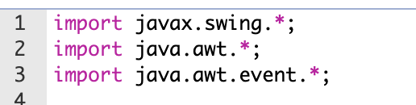
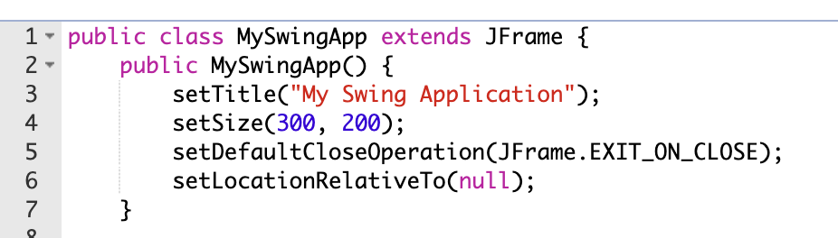
Creating a Simple Swing Application
Import Swing Packages:
Create the Main Application Class:

Slide 7
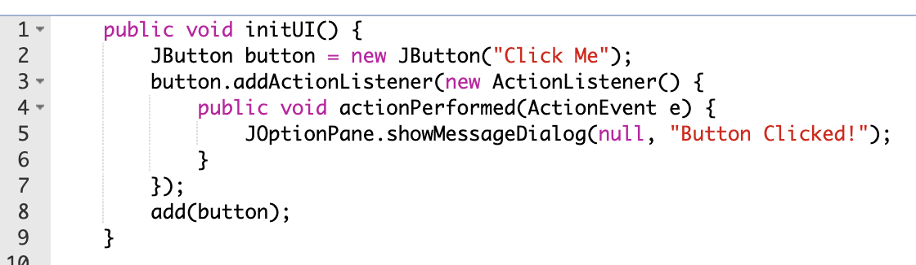
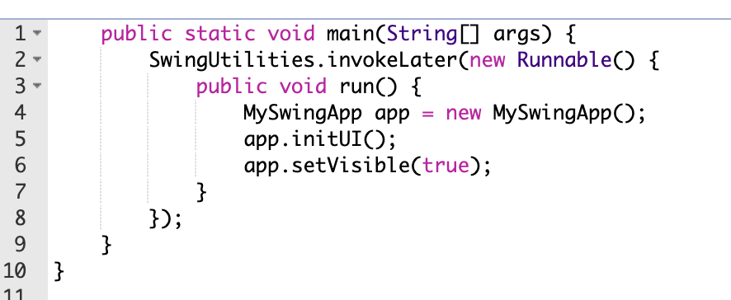
Creating a Simple Swing Application
Add Components:
Run the Application:

Slide 8
Key Swing Components
Commonly Used Swing Components
JLabel: Displays text or image.
JTextField: Single-line text input.
JTextArea: Multi-line text input.

Slide 9


Key Swing Components
Commonly Used Swing Components
JCheckBox: Checkable item.
JRadioButton: Radio button for selecting one of multiple options.
JComboBox: Dropdown menu.

Slide 10
Applying OOP Principles
Object-Oriented Programming Concepts
Encapsulation: Bundling data and methods within classes.
Inheritance: Creating new classes from existing ones.
Polymorphism: Ability to process objects differently based on their data type or class.
Abstraction: Hiding complex implementation details and showing only the necessary features.

Slide 11
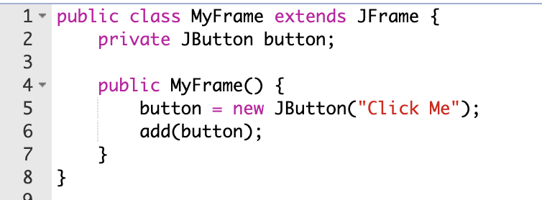
OOP in Swing Applications
Encapsulation
Encapsulate GUI components and logic within classes.

Slide 12
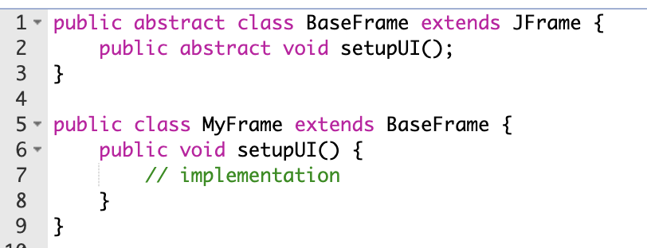
OOP in Swing Applications
Abstraction
Use abstract classes and interfaces to define common behaviors.

Slide 13
Conclusion
Today, we covered the basics of Java Swing and how to create a simple GUI application.
We also explored various Swing components and applied OOP principles in developing Swing applications.
By understanding these concepts, you can build more sophisticated and maintainable GUI applications in Java.

Slide 14
EXAMPLES
Java Swing

Slide 15
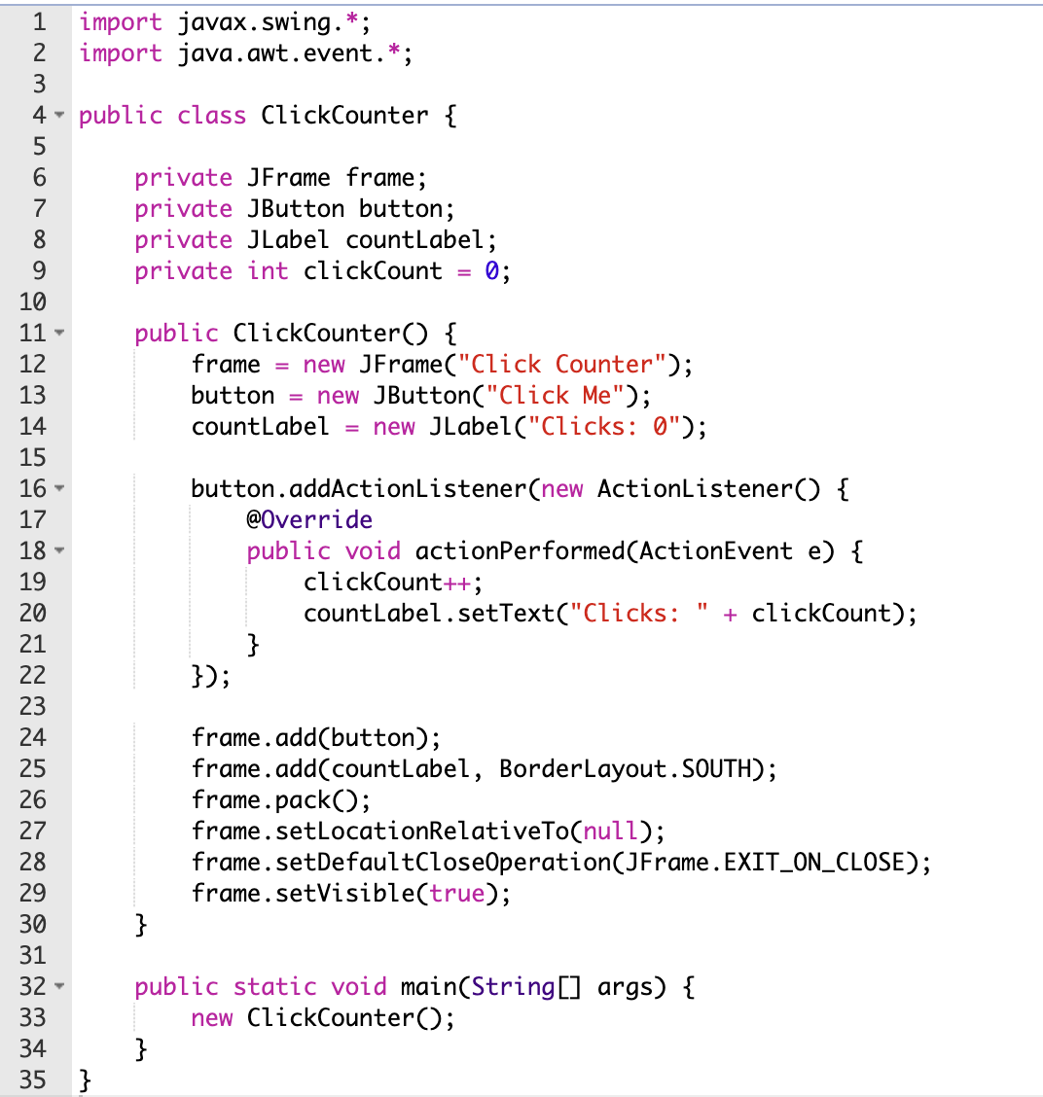
Simple Button Click Counter

Slide 16
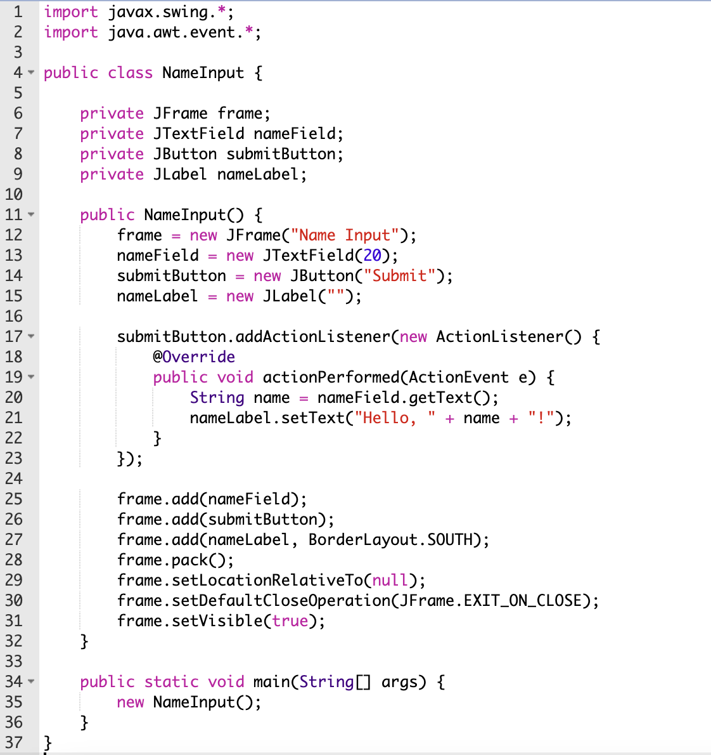
Text Field Input and Display

Slide 17
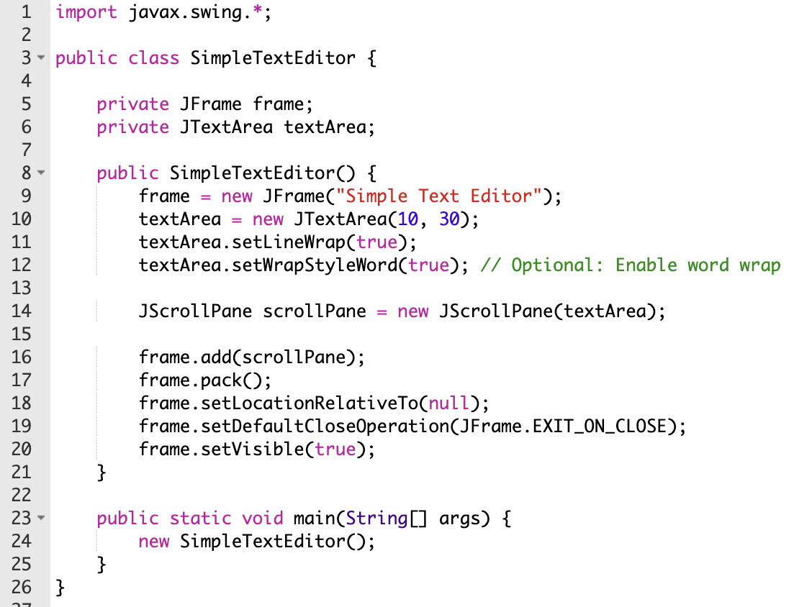
Simple Text Editor

Slide 18
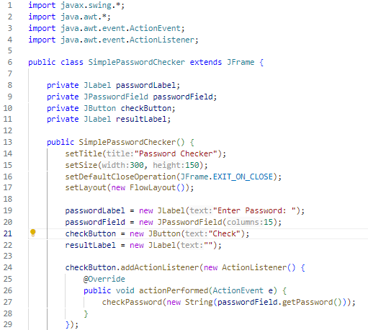
Simple Password Checker

Slide 19
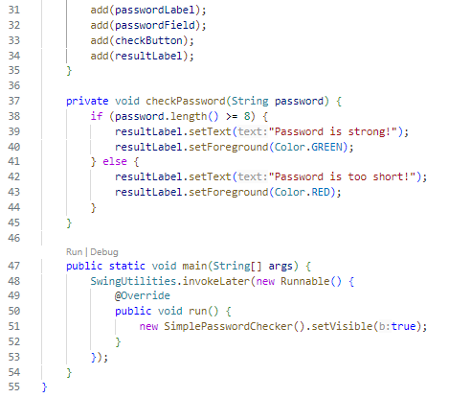
Simple Password Checker

Slide 20
REFERENCES
tackoverflow.com/questions/23205439/set-gradient-direction-in-swing
github.com/HouariZegai/java-pocs
subject to license (MIT)
stackoverflow.com/questions/71314365/looping-a-validation-consecutively
stackoverflow.com/questions/11699931/how-to-use-the-built-in-plaf-with-custom-components
pt.stackoverflow.com/questions/472217/erro-movimenta%C3%A7%C3%A3o-do-player
github.com/Sumir123/JavaSwingApp

Slide 21
Thank youuu!!

